Slide 1
Revision
What is the ratio of:
Blue to Red shapes
Squares to circles
Big to small
Red Squares to Red Circles
Notes:
hook

Slide 2
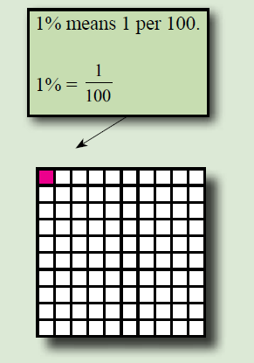
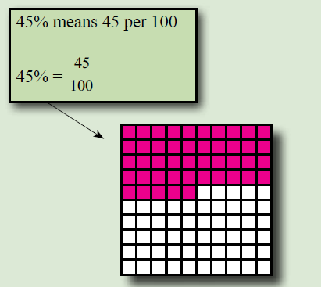
24
7
30
Date
Conversions
EQ – How do we convert to percentages?
What are percentages?
Percentage comes from Per Century , or per 100
So a percentage is a score out of 100
5
Notes:
Lesson objective (EQ)

Slide 3
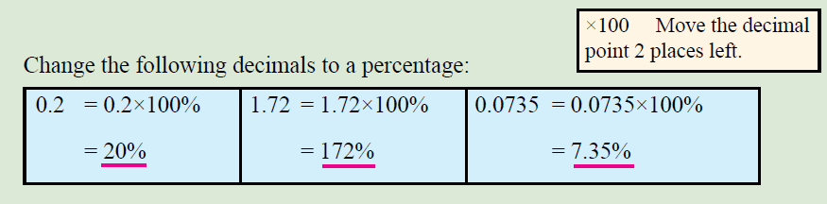
24
7
30
Date
Conversions
EQ – How do we convert to percentages?
Decimals to percentages
To convert a decimal to a percentage we multiply by 100
Eg. 0.35 is equal to 0.35 x 100% = 35%
5

Slide 4
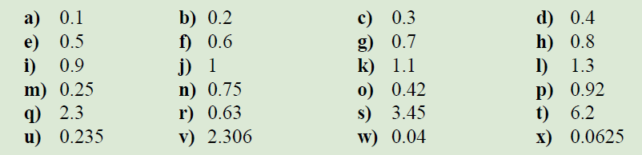

Have a go at these
This is exercise 16.4 on page 218 in the text book

Slide 5
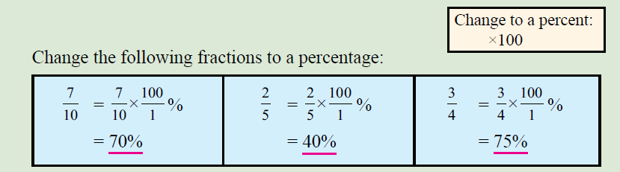
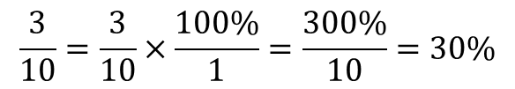
24
7
30
Date
Conversions
EQ – How do we convert to percentages?
Again we are going to multiply by 100
Fractions to percentages
$$\frac{3}{10}=\frac{3}{10}×\frac{100\%}{1}=\frac{300\%}{10}=30\%$$
5
Notes:
Input

Slide 6
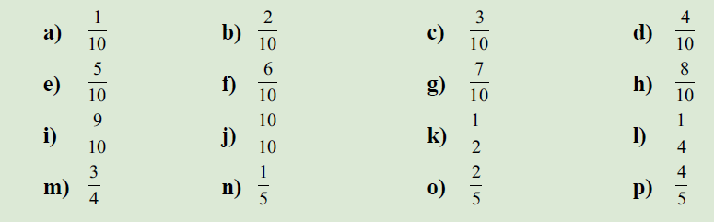

Have a go at these
This is exercise 16.5 on page 218 in the text book
Notes:
Check for understanding

Slide 7

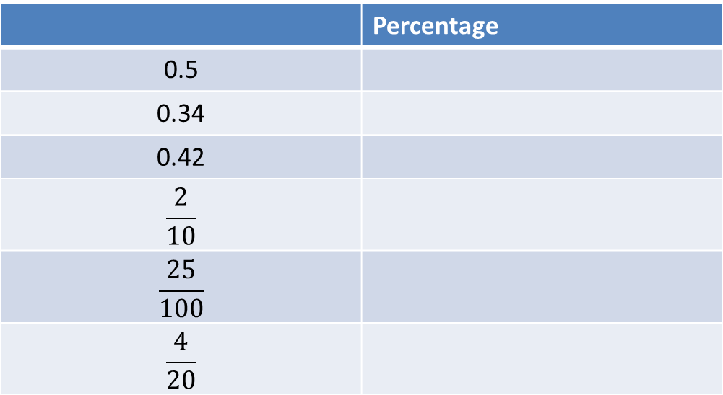
EXIT PASS
WICOR
Convert the following
 | Percentage
0.5
0.34
0.42
$$\frac{2}{10}$$
$$\frac{25}{100}$$
$$\frac{4}{20}$$
Notes:
Guided practice

